Slide 1
INTERMOLECULAR FORCES
(The force will be with you, always)

Slide 2
Intramolecular bonds and Intermolecular Forces
Intramolecular bonds are the bonds within the molecule. (covalent bonds)
Intermolecular forces are the forces of attraction between molecules due to polarity and movement of electrons within the bond.
The more polar the molecule, the stronger the intermolecular force.

Slide 3
Intermolecular forces
Intermolecular forces are weaker than ionic or covalent bonds.
The strength of the intermolecular force determines the phase (solid, liquid, or gas) that the molecules have.
Strong forces: solid phase
Weak forces: gas phase
The larger the polarity of the molecule, the stronger the intermolecular force between molecules.

Slide 4
Three types of intermolecular forces
London force: also known as the Dispersion force (Weakest)
Dipole-dipole forces (middle)
Hydrogen bond (strongest)

Slide 5
London dispersion forces aka dispersion forces aka Van der Waals forces
Weakest force
Strength increases as size increases
The only force of attraction between two nonpolar molecules.
All molecules (both polar and nonpolar) have some London forces between them.
Due to the random back and forth movement of shared electrons.

Slide 6
Dipole-Dipole forces
Force of attraction between two polar molecules.
The larger in size of the polar molecule, the weaker the dipole force because the molecules can’t get as close to each other.

Slide 7
Hydrogen Bonds
Attraction occuring when a hydrogen atom is bonded to a very small but strongly electronegative atom (such as fluorine, oxygen, or nitrogen)
This happens because hydrogen is so small in size, it can get close to another molecule and therefore have a greater effect.

Slide 8
Hydrogen Bonding
Hydrogen bonding is F.O.N.
Hydrogen bonding isn’t a bond. It’s an Intermolecular force. The molecule must have Hydrogen bonded to Fluorine, Oxygen or Nitrogen.
F, O, and N have very high electronegativities and are very small. This combination of strong attraction for bonding electrons and small size really pulls the electrons close to them.
This creates a very large partial negative around them, which in turn causes a very strong attraction between the F,O or N of that molecule and the Hydrogen of a different molecule (think of how 2 strong magnets would attract...same thing)

Slide 9
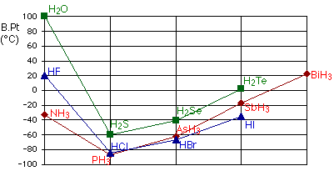
Hydrogen bonding and how it affects boiling point.
H₂O, HF, and NH₃ are polar molecules that have hydrogen bonding (which is very strong) as their IMFs so it takes more energy to break the IMF and cause them to boil.
The other molecules are non polar molecules which have dispersion forces, which are weak but increase as their size increases

Slide 10
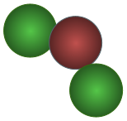
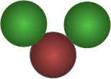
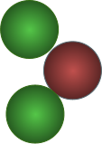
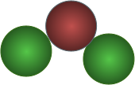
Intermolecular forces
London
+
-
+
-
+
-
+
Dipole-dipole
-
+
+
+
+
-
-
-
Hydrogen Bonding
+
+
+

